Slide 1
Advanced Statistic & Hypothesis Testing

Slide 2
Trainer Guidelines for Conducting Class
Solve questions live by creating new blank files (Excel, Python, Jupyter notebook, Dashboard) during the session, rather than sharing completed solutions.
Review teaching materials and solutions beforehand, and prepare additional examples to reinforce learning.
Ensure online students can hear you and see the screen clearly at all times.
Test your computer and necessary software before class begins.
Check with online students every 15-20 minutes to see if they understand the material and have any questions.

Slide 3
Agenda
Hypothesis Testing - Null & Alternative
Significance Level (Alpha) & P-value
One-sample & Two-sample T-test
Visualization Plots For Data Exploration
Interpretation Of Visualization
Correlation & Regression
Confidence Interval
Hypothesis Testing With Z-test
Chi-square Test For Categorical Data
One-way & Two-way Anova

Slide 4
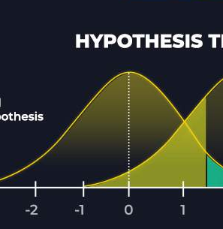
Hypothesis Testing

Slide 5
Hypothesis Testing
Hypothesis testing is a fundamental statistical method used to assess claims or hypotheses about populations based on sample data. It involves two key hypotheses:
Null Hypothesis (H0): This is the default assumption or status quo. It suggests that there is no significant effect, difference, or relationship in the population.
Alternative Hypothesis (Ha): This contradicts the null hypothesis and suggests that there is a significant effect, difference, or relationship in the population.

Slide 6
Hypothesis Testing Steps
Data
State Hypothesis
Select Test Statistic
Calculate Test Statistic
Do Not Reject Ho
Statistical Decision
Reject Ho
Calculate Ho may be true
Calculate H_{A} is true

Slide 7

Significance Level (Alpha) & P-value

Slide 8
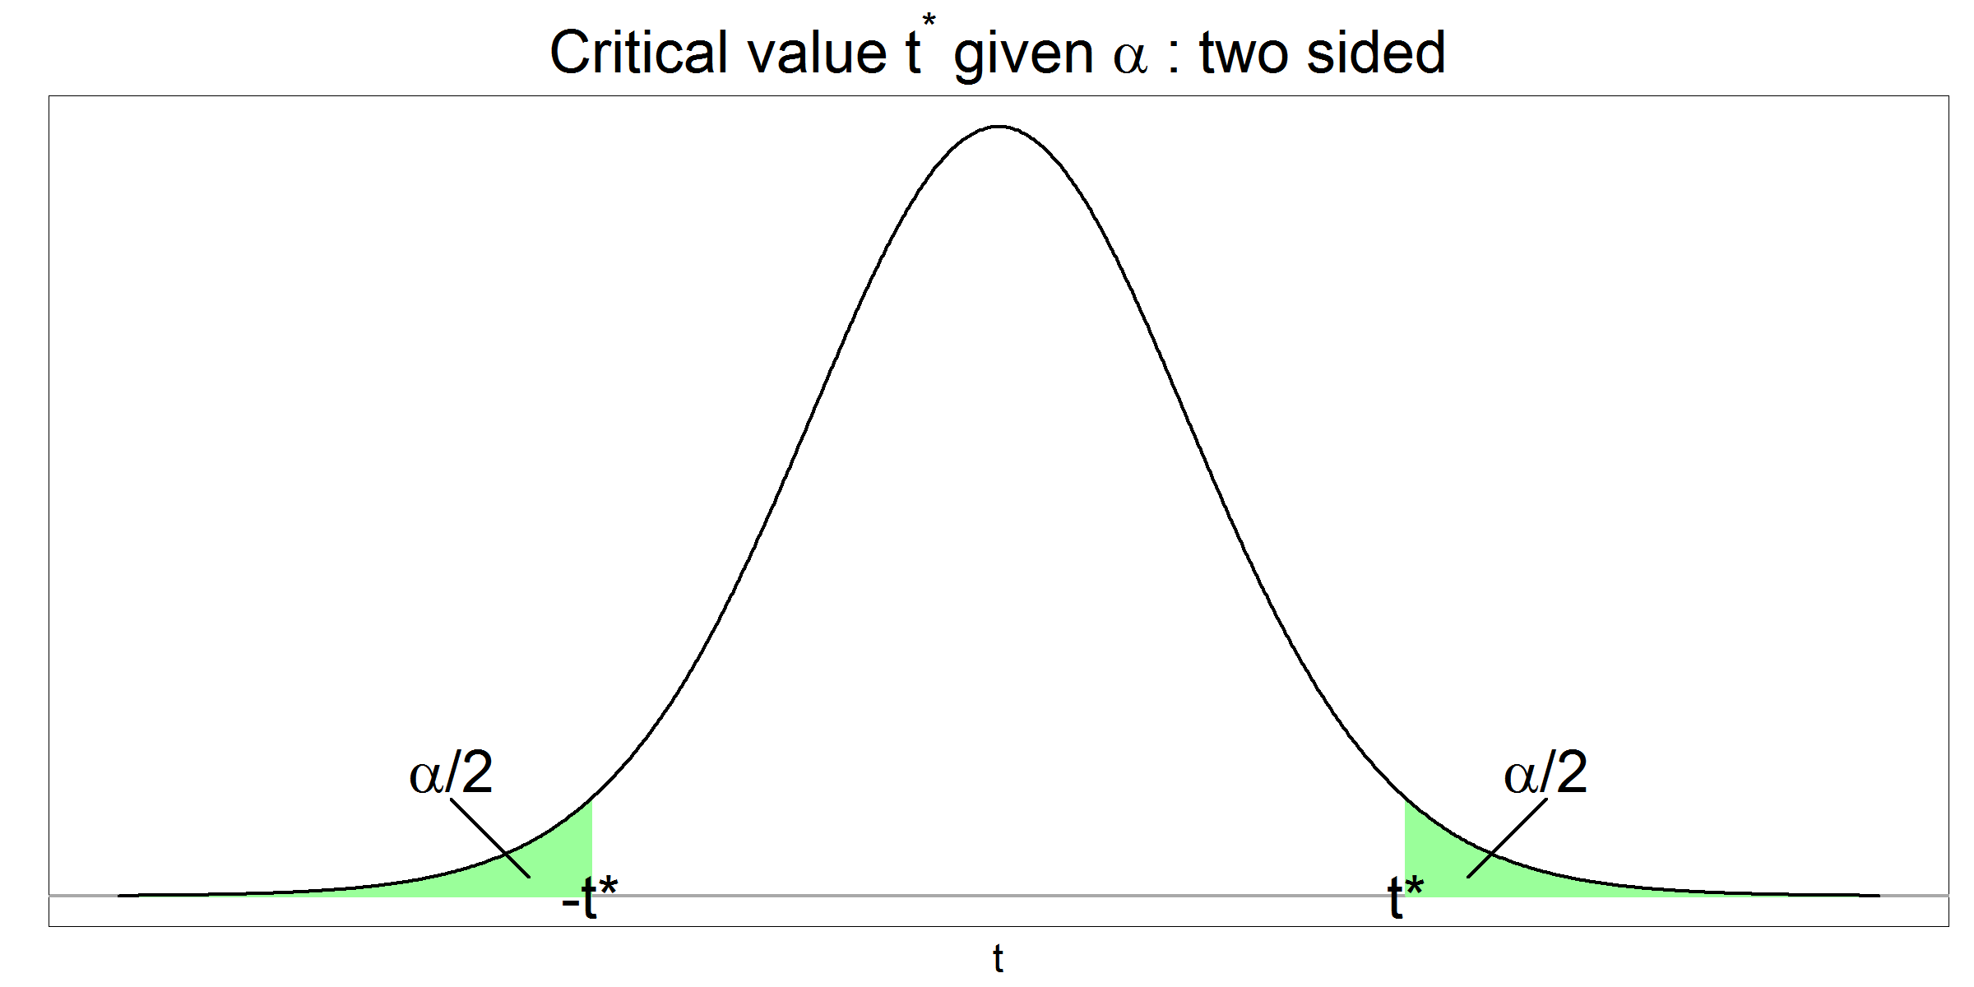
Significance Level (α)
The significance level, denoted as α (alpha), is a predetermined threshold used in hypothesis testing to determine the level of evidence required to reject the null hypothesis. It represents the maximum acceptable probability of making a Type I error (False Positive), which is the error of rejecting a true null hypothesis.
Commonly used significance levels include α = 0.05 (5%), α = 0.01 (1%), and α = 0.10 (10%).

Slide 9

Confidence Interval

Slide 10
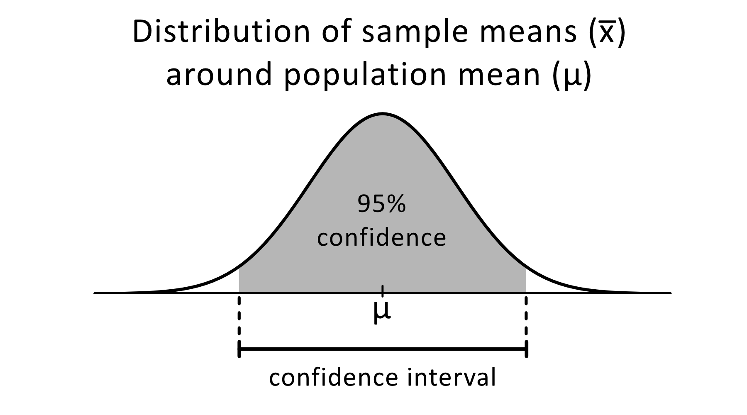
Confidence Interval
Confidence, in statistics, is another way to describe probability. For example, if you construct a confidence interval with a 95% confidence level, you are confident that 95 out of 100 times the estimate will fall between the upper and lower values specified by the confidence interval.
Your desired confidence level is usually one minus the alpha (α) value you used in your statistical test
Confidence level = 1 − a
So, if you use an alpha value of p < 0.05 for statistical significance, then your confidence level would be 1 − 0.05 = 0.95, or 95%.

Slide 11
Cont..
Calculation and Interpretation
Confidence intervals are typically calculated using a formula that incorporates the sample statistic, the standard error (a measure of variability), and a critical value from a statistical distribution (e.g., the normal distribution or t-distribution). The formula is:
CI = Sample Statistic ± Margin of Error
Interpretation: A confidence interval consists of two parts:
The point estimate (sample statistic), which is the best guess for the population parameter.
The margin of error, which represents the range around the point estimate. It reflects the precision of the estimate and is determined by the chosen confidence level.

Slide 13
P-Value
The p-value is a statistical measure that quantifies the strength of evidence against the null hypothesis. It represents the probability of observing sample data as extreme as, or more extreme than, the data observed, assuming the null hypothesis is true. A smaller p-value indicates stronger evidence against the null hypothesis.
Definition: A p-value measures the strength of evidence against the null hypothesis in hypothesis testing.
Interpretation: Smaller p-values indicate stronger evidence against the null hypothesis.
Decision: If p ≤ α (chosen significance level, e.g., 0.05), you reject the null hypothesis; if p > α, you fail to reject it.
Example: Setting Alpha at 0.05 and Interpreting a P-Value of 0.03

Slide 14
Cont…
Significance Level (α):
Chose a significance level of α = 0.05.
Accepted a 5% chance of Type I error (false rejection of a true null hypothesis).
P-Value Interpretation:
Obtained a p-value of 0.03.
P-value is less than α (0.05).
Indicates a 3% probability of observing the data or more extreme if the null hypothesis were true.
Decision:
Given the p-value is less than α.
Typically, reject the null hypothesis in favor of the alternative hypothesis.
Strong evidence against the null hypothesis.
Conclusion:
Statistical basis to reject the null hypothesis.
The observed data supports the conclusion that the null hypothesis is unlikely to be true.

Slide 15
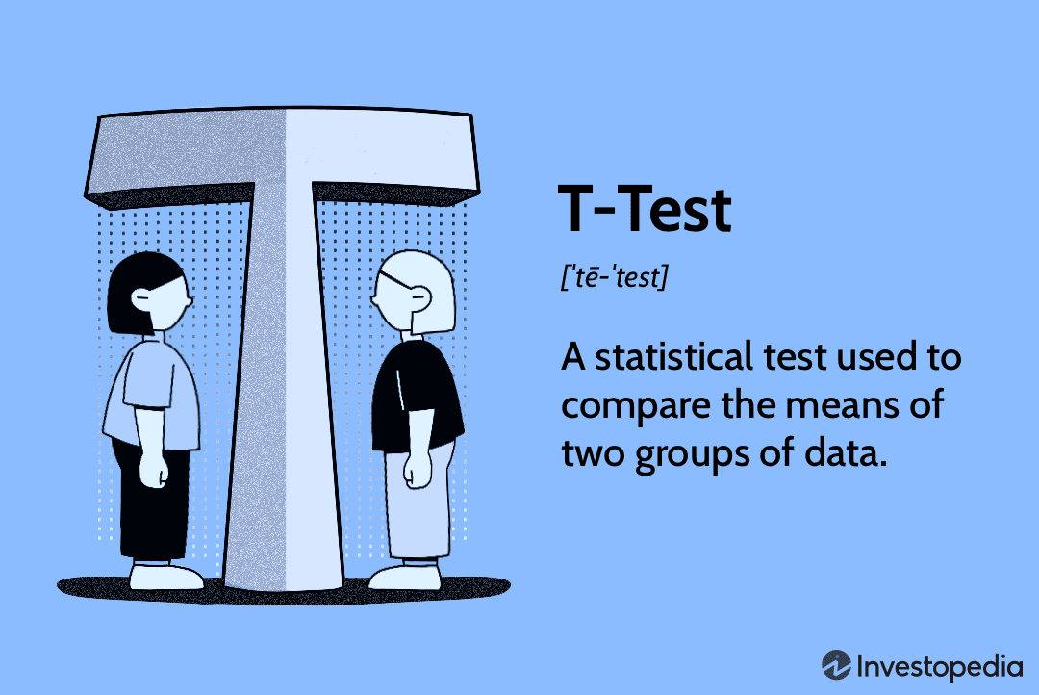
One-sample & Two-sample T-test

Slide 16
T-Tests
A t-test is a statistical test used to determine if there is a significant difference between the means of two groups or to test if the mean of a single sample is significantly different from a known or hypothesized population mean
One-Sample T-Test
Explanation: A one-sample t-test is used to determine if the mean of a single sample is significantly different from a known or hypothesized population mean.
Assumptions: It assumes that the sample data is approximately normally distributed and that the observations are independent.
When to Use: Use a one-sample t-test when you have one sample and want to test if its mean is different from a specified value (population mean).

Slide 17
Hypothesis Testing – One Sample T Test
Example
Suppose the coffee shop owner collects data on the wait times for a random sample of 30 customers, and the wait times (in minutes) are as follows:
4.2, 3.8 ,3.5, 4.0 ,4.5, 3.3, 4.2, 4.1, 3.9, 4.3, 3.7, 4.0, 4.2, 3.8, 3.6, 4.1, 3.9, 4.4, 4.0, 4.2, 3.7, 3.9, 4.0, 4.1, 4.3, 3.6, 3.9, 4.0, 4.2, 4.2, 3.8, 3.5, 4.0, 4.5, 3.3, 4.2, 4.1, 3.9, 4.3, 3.7, 4.0, 4.2, 3.8, 3.6, 4.1, 3.9, 4.4, 4.0, 4.2, 3.7, 3.9, 4.0, 4.1, 4.3, 3.6, 3.9, 4.0, 4.2
Now, let's perform the hypothesis test based on this data:
Hypotheses
Null Hypothesis (H0): The average wait time is 3 minutes (μ = 3).
Alternative Hypothesis (Ha): The average wait time is not 3 minutes (μ ≠ 3).
(We're using a two-tailed test because we want to test if the average wait time is different from 3 minutes.)

Slide 18



Cont…
Steps of Hypothesis Testing
Collect Data: We have the wait times for the 30 customers in the sample.
Set Significance Level: Let's choose a significance level (α) of 0.05.
Calculate Sample Mean & Standard Deviation:
Sample Mean (x̄) = (4.2+3.8+3.5+…+4.2) / 30 =4.0 minutes
Sample Standard Deviation (s): 0.2757819000266971
Calculate Test Statistic: Using the formula:
t = (4.0−3)/0.2 =5
$$S=\sqrt{\frac{\sum{{\left(x_{i}−\overline{x}\right)}^{2}}}{n−1}}$$
$$t=\frac{\text{x}\text{̄}−μ_{0}}{\frac{s}{\sqrt{n}}}$$
$$\frac{s}{\sqrt{n}}$$
Standard Error (SE)

Slide 19
Cont…
Find Critical Values: For a two-tailed test with α = 0.05 and 29 degrees of freedom (df = n - 1 = 30 - 1 = 29), the critical values are approximately ± 2.045.
Calculate P-Value: The p-value is calculated as the probability of observing a t-statistic as extreme as 5 in a t-distribution with 29 degrees of freedom. The p-value is extremely small, indicating strong evidence against the null hypothesis.
Make a Decision: Since the p-value (very small) is less than α (0.05), we reject the null hypothesis. This suggests that there is enough evidence to conclude that the average wait time for customers to receive their coffee is not 3 minutes.

Slide 20
Two-Sample T-Tests
Two-Sample T-Test
Explanation: A two-sample t-test is used to compare the means of two independent samples to determine if they are significantly different from each other.
Assumptions: It assumes that the data in both samples are approximately normally distributed, and the observations in each sample are independent.
When to Use: Use a two-sample t-test when you have two separate groups or samples, and you want to test if their means are significantly different from each other.

Slide 21
Cont…
Imagine you are a teacher, and you want to determine if two different teaching methods, Method A and Method B, have a significant impact on students' test scores. You have two groups of students, one taught using Method A and the other using Method B, and you want to compare their test scores to see if there's a significant difference.
Hypotheses
Null Hypothesis (H0): There is no significant difference in the mean test scores between the two teaching methods (μA = μB).
Alternative Hypothesis (Ha): There is a significant difference in the mean test scores between the two teaching methods (μA ≠ μB).
.

Slide 22
Cont…
Steps of the Two-Sample T-Test
Collect Data: Collect test scores from two groups of students. Let's assume:
Group A (Method A): [85, 88, 92, 78, 90]
Group B (Method B): [91, 89, 82, 87, 88]
Set Significance Level (α): Choose a significance level, such as α = 0.05, to determine the threshold for statistical significance.
Calculate Sample Means: Calculate the sample means for both groups:
Sample Mean of Group A (x̄A) = (85 + 88 + 92 + 78 + 90) / 5 = 86.6
Sample Mean of Group B (x̄B) = (91 + 89 + 82 + 87 + 88) / 5 = 87.

Slide 23
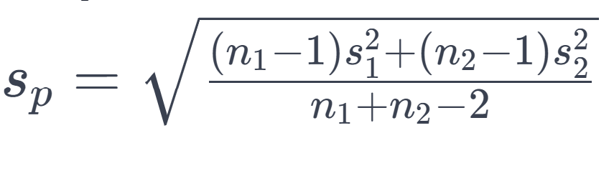
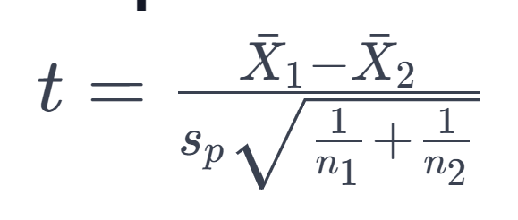
Cont…
Calculate Standard Deviations: Calculate the sample standard deviations for both groups, which measure the variability within each group.
Standard Deviation for Group A: 5.458937625582472
Standard Deviation for Group B: 3.361547262794322
Pooled Standard Deviation: 4.533210782657254
Calculate p-Value
t-Statistic: - 0.27903204256606634

Slide 24
Cont…
Determine Degrees of Freedom (df)
df = n1 + n2 – 2 = 5 + 5 - 2
df = 8
Make a Decision: Compare the p-value to α. If p ≤ α, reject the null hypothesis, indicating a significant difference in test scores between the two teaching methods. If p > α, fail to reject the null hypothesis. Here,
|t-statistic| > Critical Value, you may reject the null hypothesis.

Slide 25
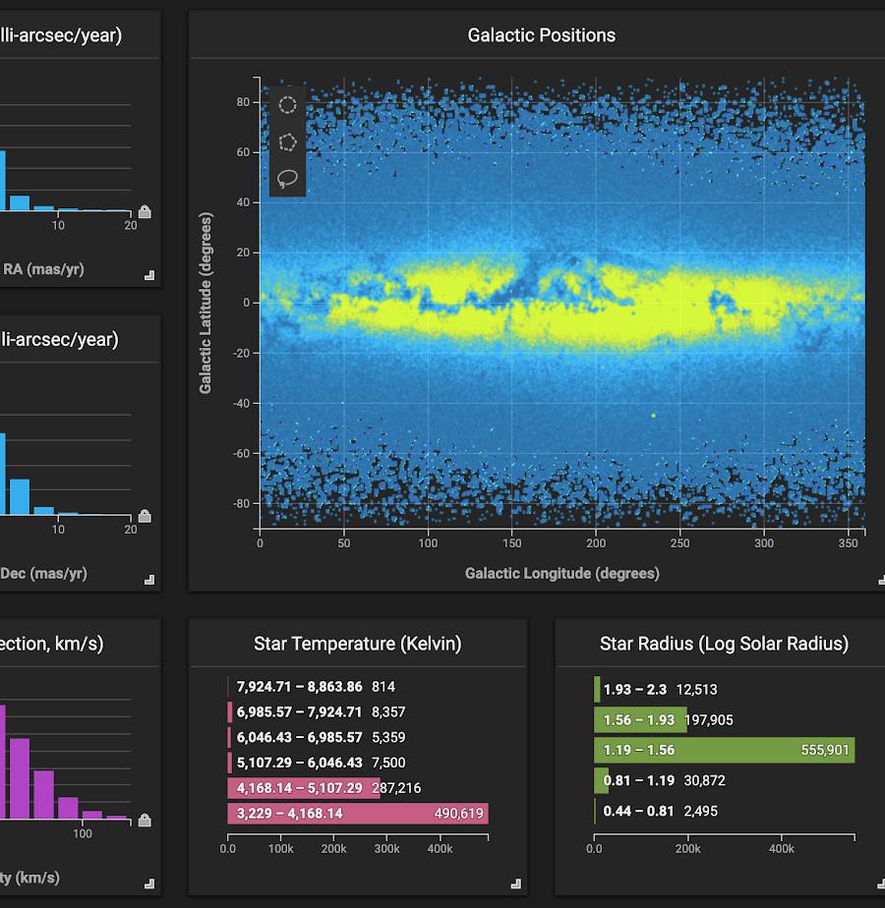
Visualization Plots For Data Exploration

Slide 26

Visualization Plots for Data Exploration
Histograms
Box Plots (Box-and-Whisker Plots)
Scatter Plots
Bar Charts
Line Charts
Heatmaps

Slide 27

Interpretation Of Visualization

Slide 28
Interpretation of Visualization
Interpretation of Visualization
Guidelines: Understand plot-specific conventions.
Patterns: Identify trends, relationships, or groupings.
Outliers: Spot data points deviating from the pattern.
Example: Scatter Plot Analysis
Pattern: Look for upward or downward trends.
Outliers: Identify exceptional data points.
Interpreting visualizations helps extract insights and make informed decisions.

Slide 29
Scatter Plot Analysis
Example
Scatter Plot Analysis - Relationship between Study Hours and Exam Scores
Data: Suppose you have collected data on the study hours and corresponding exam scores for a group of students
Study Hours (hours) | Exam Scores (out of 100)
1 | 50
2 | 60
3 | 70
4 | 75
5 | 80
6 | 85
7 | 90
8 | 92
9 | 95
10 | 98

Slide 30
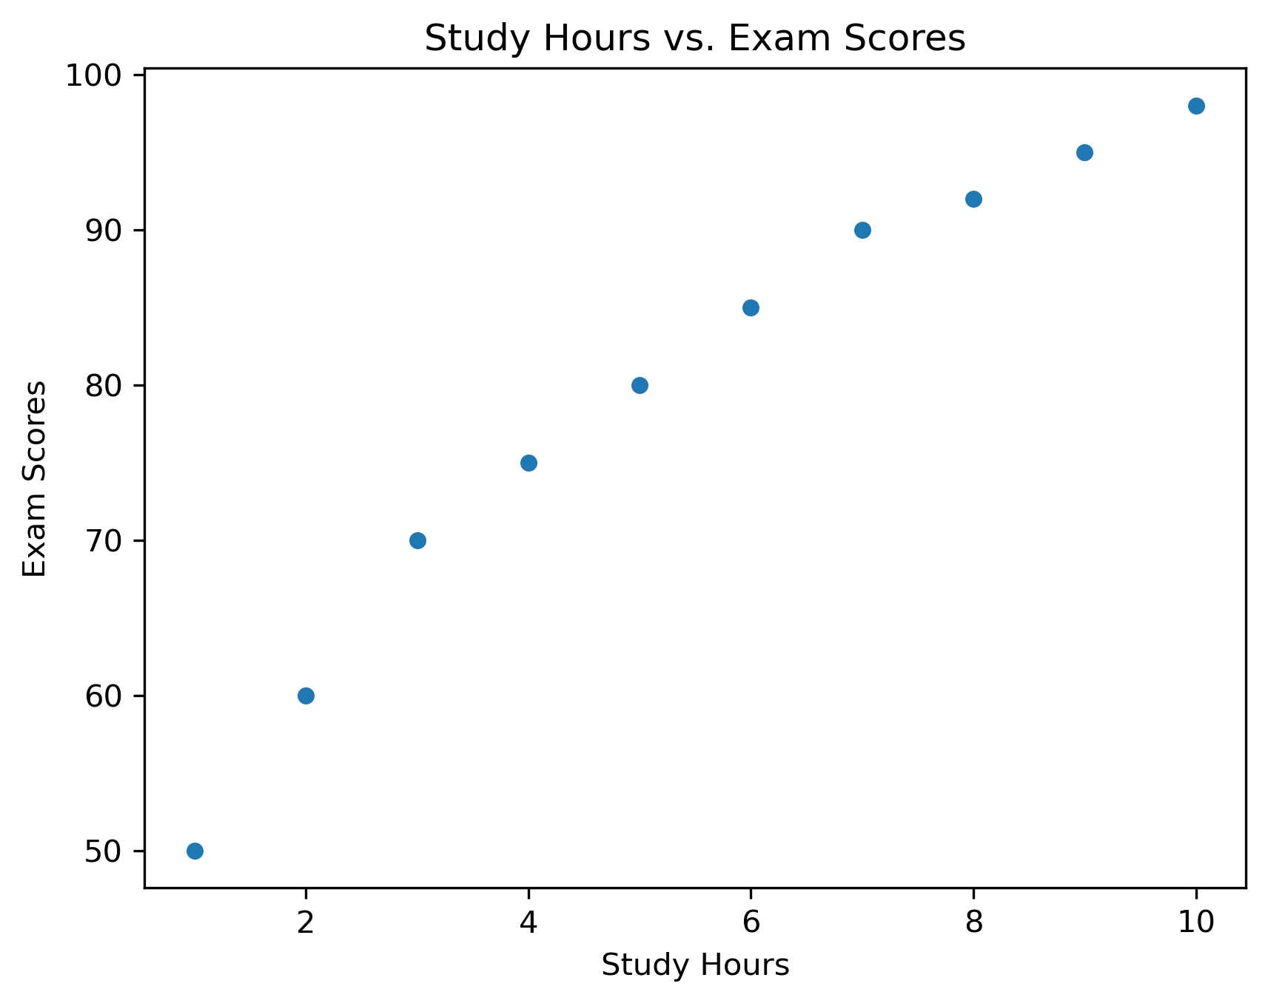
Cont…
Interpretation
Pattern: The scatter plot shows a clear upward trend, indicating a positive correlation between study hours and exam scores. More study hours generally lead to better exam performance.
Outliers: No significant outliers are observed; all data points align with the trend.
This interpretation highlights the positive relationship between study hours and exam scores, emphasizing the benefits of increased study time on academic performance.

Slide 31

Correlation & Regression

Slide 32
Correlation and Regression
Correlation - Measure of Association
Correlation is a statistical measure that quantifies the degree and direction of a relationship between two variables. It assesses how changes in one variable are associated with changes in another.
Linear Regression - Modeling Relationships
Linear regression is a statistical technique used to model the relationship between a dependent variable (response) and one or more independent variables (predictors). It assumes a linear relationship and helps predict the dependent variable based on the independent variables.

Slide 33
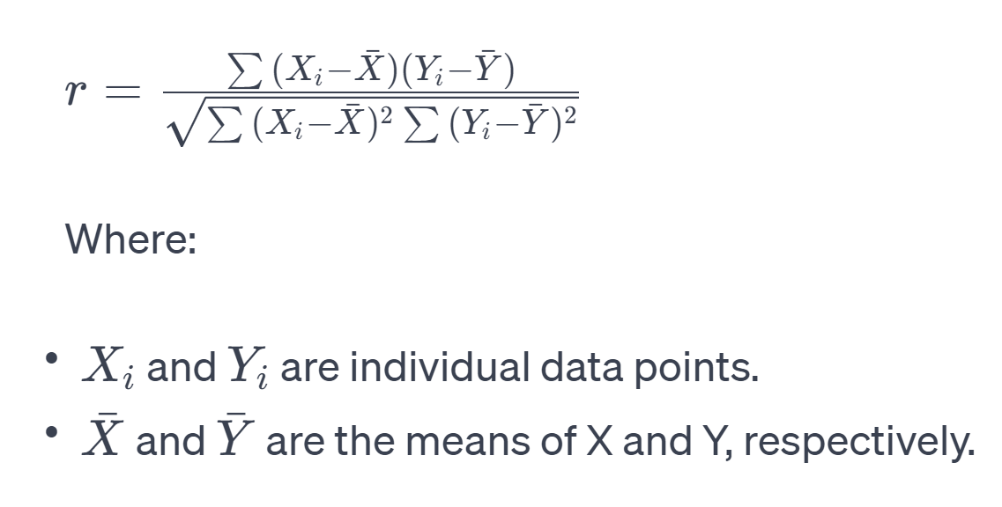
Cont..
Example: Calculating and Interpreting Correlation Coefficients:
Suppose you are analyzing the relationship between study hours and exam scores for a group of students. You want to calculate and interpret the correlation coefficient between these two variables
Data: You have data on study hours (X) and corresponding exam scores (Y) for several students.
Calculate Correlation: You calculate the correlation coefficient, which can be Pearson's correlation coefficient (r), Spearman's rank correlation coefficient, or others, depending on the data characteristics.

Slide 34
Cont..
Interpretation
If r is close to 1: Strong positive correlation; as study hours increase, exam scores tend to increase significantly.
If r is close to -1: Strong negative correlation; as study hours increase, exam scores tend to decrease significantly.
If r is close to 0: Weak or no linear correlation; study hours and exam scores are not strongly associated.
Correlation helps quantify the strength and direction of the relationship between study hours and exam scores. Linear regression, on the other hand, can further model and predict exam scores based on study hours and may provide insights into the extent of predictability.

Slide 35
Confidence Interval
Confidence, in statistics, is another way to describe probability. For example, if you construct a confidence interval with a 95% confidence level, you are confident that 95 out of 100 times the estimate will fall between the upper and lower values specified by the confidence interval.
Your desired confidence level is usually one minus the alpha (α) value you used in your statistical test
Confidence level = 1 − a
So, if you use an alpha value of p < 0.05 for statistical significance, then your confidence level would be 1 − 0.05 = 0.95, or 95%.

Slide 36
Cont..
Calculation and Interpretation
Confidence intervals are typically calculated using a formula that incorporates the sample statistic, the standard error (a measure of variability), and a critical value from a statistical distribution (e.g., the normal distribution or t-distribution). The formula is:
CI = Sample Statistic ± Margin of Error
Interpretation: A confidence interval consists of two parts:
The point estimate (sample statistic), which is the best guess for the population parameter.
The margin of error, which represents the range around the point estimate. It reflects the precision of the estimate and is determined by the chosen confidence level.

Slide 37
Confidence Interval

Slide 38
Confidence Interval
For a z statistic, some of the most common values are shown in this table
Confidence level | 90% | 95% | 99%
alpha for one-tailed CI | 0.1 | 0.05 | 0.01
alpha for two-tailed CI | 0.05 | 0.025 | 0.005
z statistic | 1.64 | 1.96 | 2.57

Slide 39
Cont…
Example: Determining the Confidence Interval for the Mean Height of a Population
Scenario: Imagine you want to estimate the average height of all adults in a country. You collect a sample of heights from 100 individuals and calculate the sample mean height to be 170 cm with a standard deviation of 5 cm. You want to determine a 95% confidence interval for the mean height.
Data: You collect a sample of heights from 100 individuals and calculate the sample mean height to be 170 cm with a standard deviation of 5 cm.
Goal: Determine a 95% confidence interval for the mean height.

Slide 40
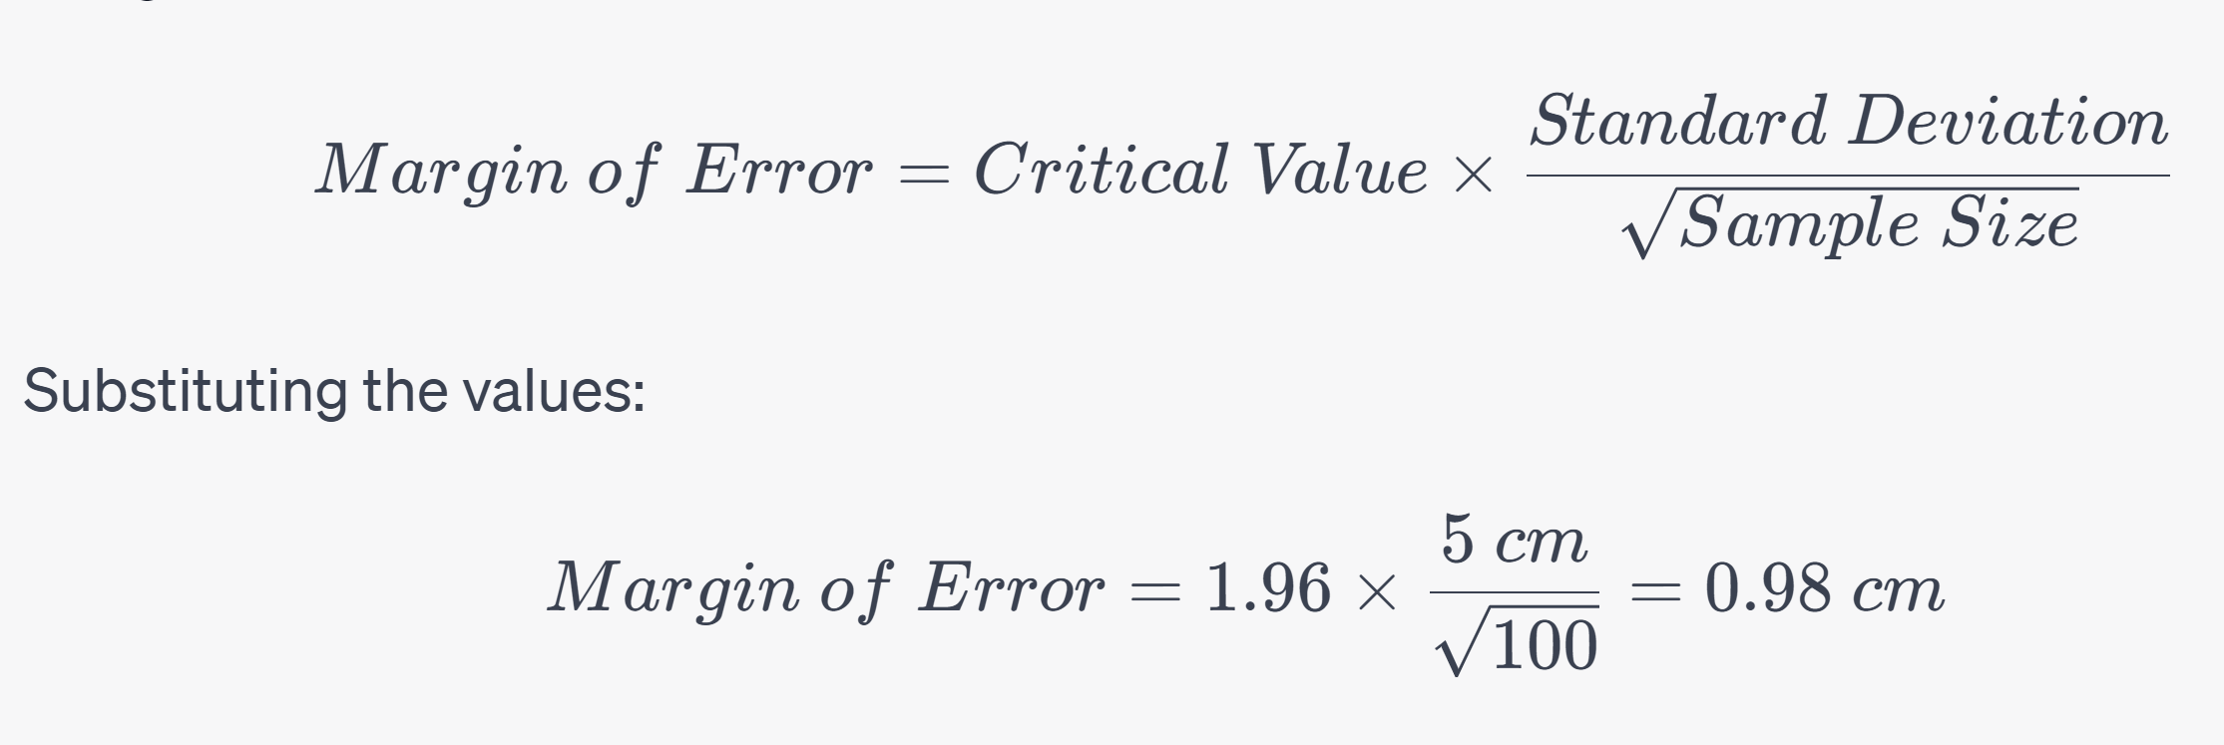
Cont…
Step 1: Calculation of Margin of Error To calculate the margin of error for the confidence interval, you need two components:
Critical Value: Using the t-distribution (since it's a sample) and a 95% confidence level, you find the critical value. For this example, let's assume it's 1.96. This critical value represents how many standard errors the margin of error should cover to achieve a 95% confidence level.
Standard Error: The standard error measures the variability of the sample mean. It's calculated as the standard deviation divided by the square root of the sample size.
Margin of Error Calculation

Slide 41
Cont…
Step 2: Constructing the Confidence Interval Now that you have the margin of error, you can construct the confidence interval. The confidence interval formula is as follows:
CI=Sample Mean± Margin of Error
Substituting the values
CI = 170 cm ± 0.98 cm
Interpretation: This means you are 95% confident that the true average height of all adults in the country falls within the range of 169.02 cm to 170.98 cm.
Explanation: By calculating a confidence interval, you provide a range of heights within which you believe the true population average height is likely to be. In this case, with 95% confidence, you estimate that the average height of all adults in the country lies between 169.02 cm and 170.98 cm. The margin of error (0.98 cm) accounts for the uncertainty associated with estimating the population mean from a sample.

Slide 42

Hypothesis Testing With Z-test

Slide 43
Hypothesis Testing with Z-Test
Introduction to the Z-Test for Large Sample Sizes
Z-Test: The Z-test is a statistical hypothesis test used to assess whether a sample mean is significantly different from a known population mean when the sample size is sufficiently large. It relies on the standard normal distribution and is suitable when the population standard deviation is known.
Comparison with the t-Test
Comparison: The Z-test and t-test are both used for hypothesis testing, but they differ in their assumptions about the population standard deviation and sample size:
Z-Test: Assumes a known population standard deviation and is appropriate for large sample sizes (typically n > 30).
t-Test: Assumes an unknown population standard deviation and is suitable for smaller sample sizes.

Slide 44
Comparison: T test & Z test
Aspect | T-Test | Z-Test
Purpose | Compare means of two groups (small samples) | Compare a sample mean to a known population mean (large samples)
Sample Size | Small sample sizes (typically < 30) | Large sample sizes (typically ≥ 30)
Population SD | Unknown and estimated from the sample | Known or estimated from a large sample
Distribution | Follows the t-distribution | Follows the standard normal (z) distribution
Formula | t =​ (Xˉ−μ​) / (s/√n) | z = (​Xˉ−μ​) / (σ/√n)
Critical Values | Use t-distribution tables | Use standard normal (z) distribution tables
Common Use Case | Comparing means when SD is unknown | Comparing a sample mean to a known population mean
Example | Compare test scores of two groups | Compare the average height of a sample to a known population mean

Slide 45
Steps in z test
Step 1: Formulate Hypotheses
Step 2: Set Significance Level
Step 3: Calculate the Sample Mean and Standard Deviation
Step 4: Set Up the Z-Test Statistic
Step 5: Find Critical Value or P-Value
Step 6: Make a Decision

Slide 46
Cont…
Example: Using a Z-Test to Assess Average Weight Loss
Imagine you're evaluating the effectiveness of a weight loss program. You collect data on the weight loss of 100 participants who completed the program and want to test if, on average, participants lost a significant amount of weight.
Here's a sample dataset generated randomly
import random
# Generate sample weight loss data (in pounds)
random.seed(42) # For reproducibility
weight_loss_data = [random.uniform(0.5, 10) for _ in range(100)]
Formulate Hypotheses
Null Hypothesis (H0): The average weight loss in the program is equal to or less than zero (μ ≤ 0).
Alternative Hypothesis (Ha): The average weight loss in the program is greater than zero (μ > 0).

Slide 47
Cont…
Calculate the Test Statistic (Z-Score)
Sample Mean (X̄): Calculate the sample mean of weight loss data.
Population Standard Deviation (σ): Known as 2 pounds.
Sample Size (n): 100 participants.
import numpy as np
# Calculate sample mean and sample standard deviation
sample_mean = np.mean(weight_loss_data)
sample_std = np.std(weight_loss_data, ddof=1) # Use Bessel's correction for sample std
# Calculate Z-score
population_mean = 0 # Hypothesized population mean
z_score = (sample_mean - population_mean) / (sample_std / np.sqrt(len(weight_loss_data)))
sample_mean, sample_std, z_score
Sample Mean (X̄): Approximately 5.44 pounds
Sample Standard Deviation (s): Approximately 2.51 pounds
Z-Score (Z): Approximately 8.62

Slide 48
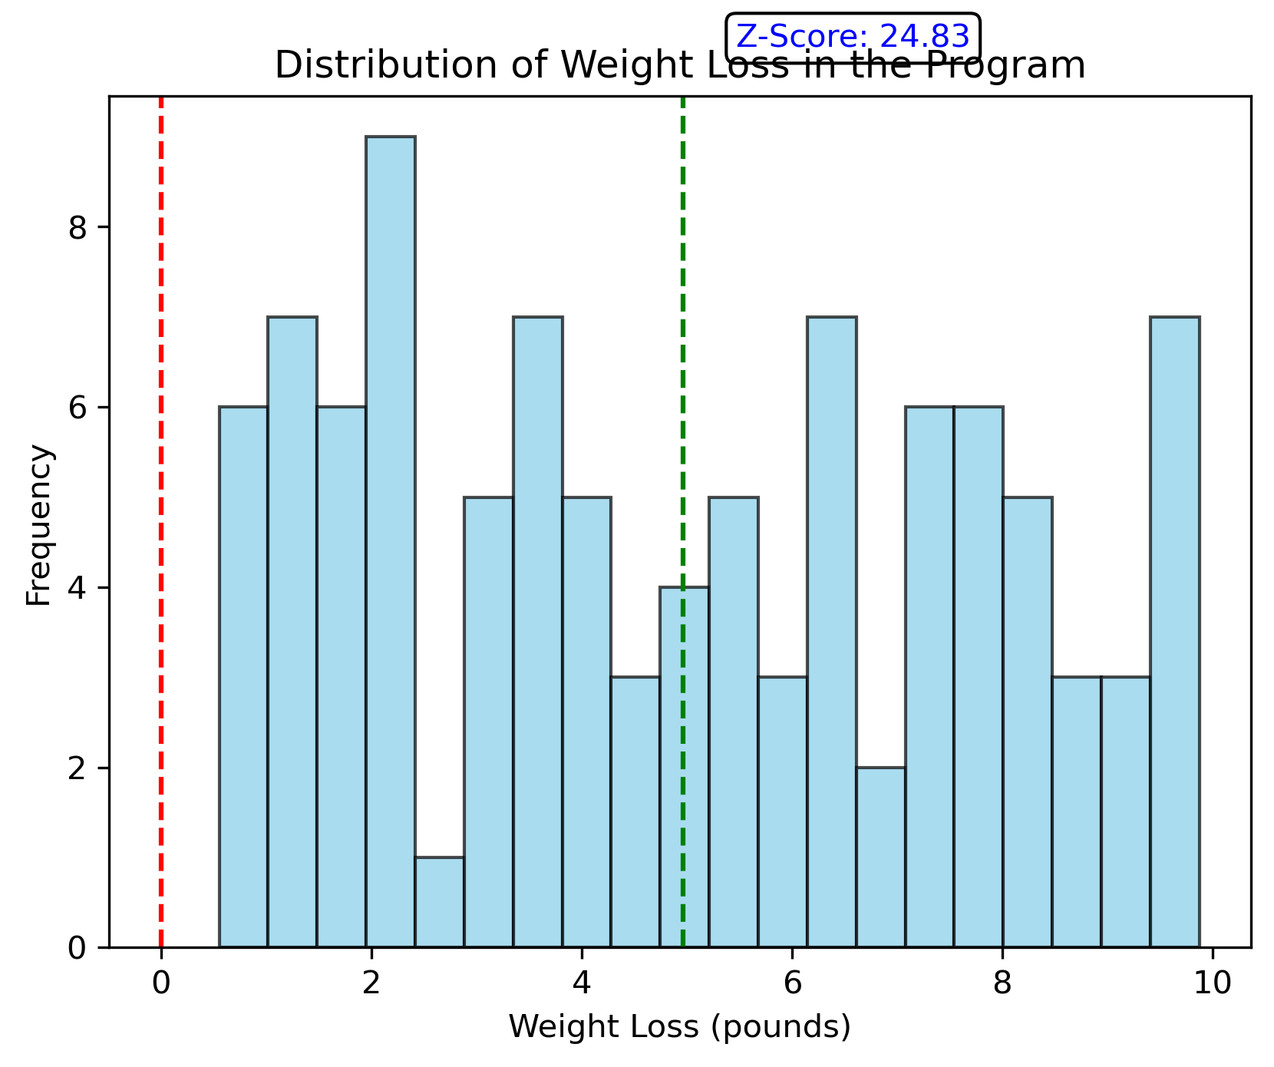
Cont…

Slide 49
Cont…
Determine the Critical Value
Significance Level (α): Typically, 0.05 (corresponding to 95% confidence level).
Degrees of Freedom (df): n - 1 (99 degrees of freedom for this example).
from scipy.stats import norm
alpha = 0.05
df = len(weight_loss_data) - 1
# Calculate the critical Z-value
critical_value = norm.ppf(1 - alpha)
critical_value
Critical Value (Z_critical): Approximately 1.645 (for α = 0.05, one-tailed test)

Slide 50
Cont…
Make a Decision
Compare the calculated Z-score with the critical value.
If Z-Score > Critical Value, reject the null hypothesis (Ha).
If Z-Score ≤ Critical Value, fail to reject the null hypothesis (H0).
# Make a decision
reject_null = z_score > critical_value
reject_null
Decision: Reject the null hypothesis (H0).
Interpret the Result
Interpret the decision in the context of the weight loss program.
Decision: Reject H0.
Interpretation: There is sufficient statistical evidence to conclude that, on average, participants in the weight loss program experienced significant weight loss.

Slide 51

Chi-square Test For Categorical Data

Slide 52
Chi-Square Test for Categorical Data
Chi-Square Test for Independence
Chi-Square Test: The chi-square test is a statistical test used to assess the independence (or association) between two categorical variables. It helps determine whether there is a significant relationship between the variables or if they are independent.
Independence: In the context of the chi-square test, independence means that the two categorical variables are not related, and changes in one variable do not affect the distribution of the other variable.

Slide 53
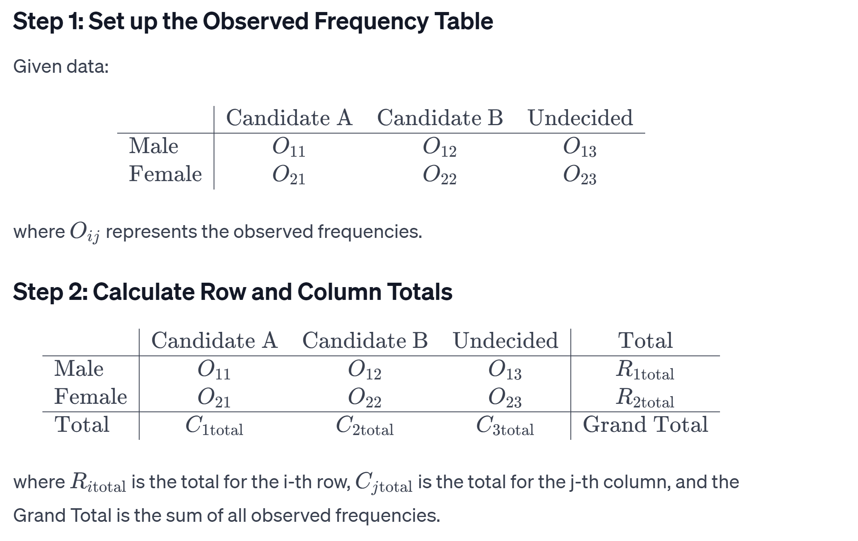
Cont..
Testing the Association Between Gender and Voting Preferences
Data: You have surveyed 200 voters in a local election to understand the association between their gender and voting preferences. Here's the dataset:

Slide 54
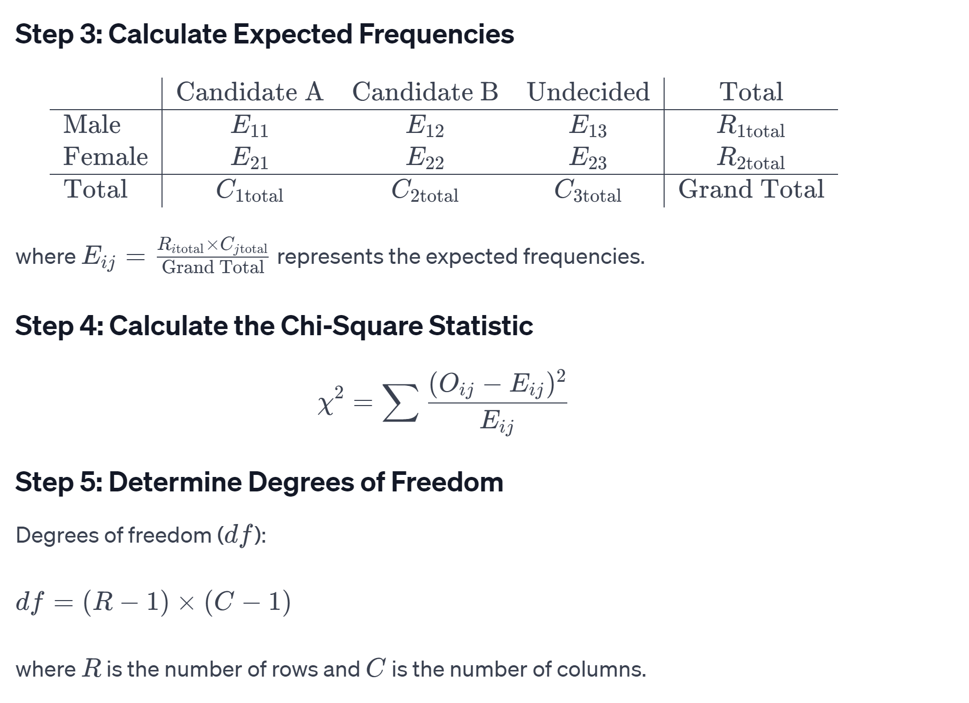
Cont..

Slide 55
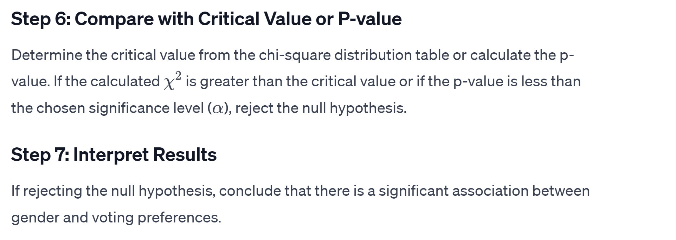
Cont..

Slide 56
Cont..
Using Python
import pandas as pd
import random
from scipy.stats import chi2_contingency
# Generate random data for 200 voters
random.seed(42) # For reproducibility
# Generate random gender data
gender = random.choices(['Male', 'Female'], k=200)
# Generate random voting preferences data
voting_preferences = random.choices(['Candidate A', 'Candidate B', 'Undecided'], k=200)
# Create a dataframe from the data
data = {
'Gender': gender,
'Voting_Preferences': voting_preferences
}
df = pd.DataFrame(data)
Please check foot note for complete code

Slide 57
Cont..
Hypotheses
You want to test whether there is a significant association between the gender of voters and their voting preferences.
Null Hypothesis (H0): Gender and voting preferences are independent.
Alternative Hypothesis (Ha): Gender and voting preferences are not independent; there is an association.
Create a Contingency Table
Create a contingency table that cross-tabulates the two categorical variables (gender and voting preferences):
contingency_table = pd.crosstab(df['Gender'], df['Voting_Preferences'])
contingency_table

Slide 58
Cont..
Calculate the Chi-Square Statistic
Calculate the chi-square statistic, which measures the discrepancy between observed and expected frequencies.
from scipy.stats import chi2_contingency
# Calculate chi-square statistic, p-value, degrees of freedom, and expected frequencies
chi2, p, dof, expected = chi2_contingency(contingency_table)
chi2, p, dof, expected
Chi-Square Statistic (χ²): Approximately 0.1463
P-Value (p): Calculated based on data
Degrees of Freedom (df): 2
Expected Frequencies: Calculated values based on the data

Slide 59
Cont..
Determine the Critical Value
Specify the desired level of significance (α) to determine the critical chi-square value. Let's assume α = 0.05.
from scipy.stats import chi2
alpha = 0.05
critical_value = chi2.ppf(1 - alpha, dof)
critical_value
Critical Value (χ²_critical): Approximately 5.991 (for α = 0.05 and df = 2)

Slide 60
Cont..
Make a Decision
Compare the calculated chi-square statistic with the critical value.
If χ² > χ²_critical, reject the null hypothesis.
If χ² ≤ χ²_critical, fail to reject the null hypothesis.
# Make a decision
reject_null = chi2 > critical_value
reject_null
Decision: Fail to reject the null hypothesis (H0).
There is insufficient evidence to conclude that there is a significant association between the gender of voters and their voting preferences in this local election. Gender and voting preferences appear to be independent.

Slide 61

One-way & Two-way ANOVA

Slide 62
One-Way and Two-Way ANOVA
Introduction to Analysis of Variance (ANOVA)
Analysis of Variance (ANOVA): ANOVA is a statistical technique used to compare means among multiple groups or treatments. It assesses whether there are any statistically significant differences between the means of the groups.
One-Way and Two-Way ANOVA
One-Way ANOVA: One-way ANOVA is used when there is one categorical independent variable (with two or more levels or groups) and one continuous dependent variable. It tests whether there are any significant differences between the means of the groups.
Two-Way ANOVA: Two-way ANOVA is used when there are two categorical independent variables (factors) and one continuous dependent variable. It assesses the interaction effect between the two factors and whether they have a significant influence on the dependent variable.

Slide 63
Cont…
Example: Performing a One-Way ANOVA to Compare Test Scores Across Different Schools
school_1 = 85, 88, 90, 92, 86
school_2 = 78, 82, 80, 85, 88
school_3 = 92, 94, 89, 88, 90
Formulate Hypotheses
Null Hypothesis (H0): There are no significant differences in test scores among the three schools.
Alternative Hypothesis (Ha): There are significant differences in test scores among the three schools.

Slide 64
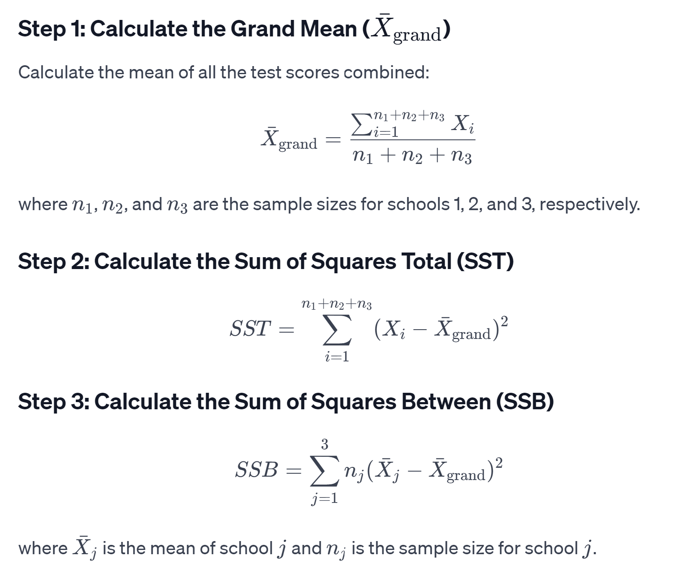
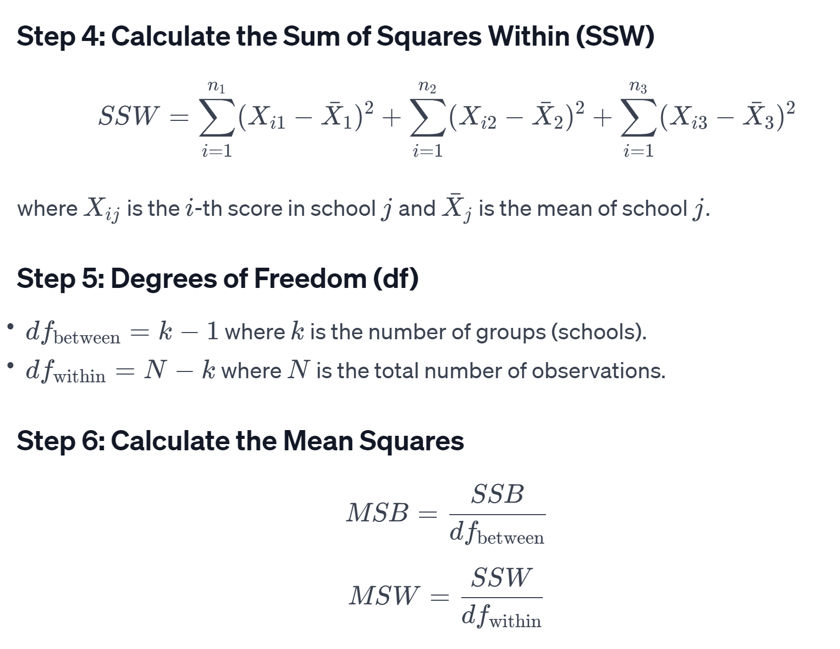
Cont…

Slide 65
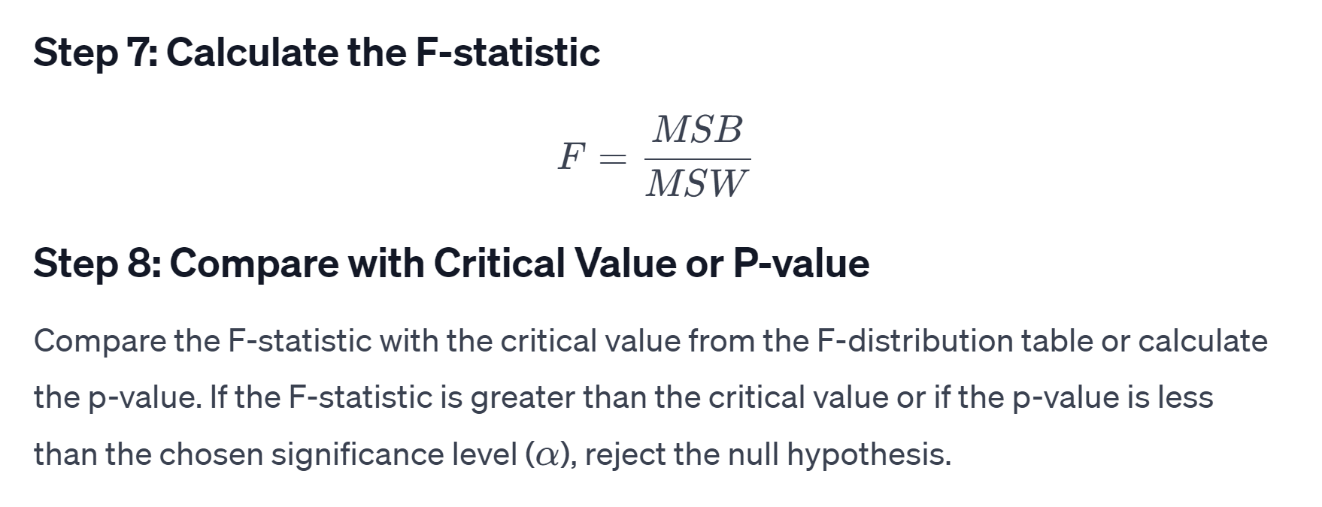
Cont…
Please check footnotes for Mathematical Python Code
Notes:
import numpy as np
from scipy.stats import f
# Given data
school_1 = np.array([85, 88, 90, 92, 86])
school_2 = np.array([78, 82, 80, 85, 88])
school_3 = np.array([92, 94, 89, 88, 90])
# Step 1: Calculate Grand Mean
all_scores = np.concatenate([school_1, school_2, school_3])
grand_mean = np.mean(all_scores)
# Step 2: Calculate SST
sst = np.sum((all_scores - grand_mean)**2)
# Step 3: Calculate SSB
ssb = np.sum([len(school) * (np.mean(school) - grand_mean)**2 for school in [school_1, school_2, school_3]])
# Step 4: Calculate SSW
ssw = np.sum([(score - np.mean(school))**2 for school, scores in zip([school_1, school_2, school_3], [school_1, school_2, school_3]) for score in scores])
# Step 5: Degrees of Freedom
df_between = 3 - 1
df_within = len(all_scores) - 3
# Step 6: Calculate Mean Squares
msb = ssb / df_between
msw = ssw / df_within
# Step 7: Calculate F-statistic
f_statistic = msb / msw
# Step 8: Compare with Critical Value or P-value
p_value = 1 - f.cdf(f_statistic, df_between, df_within)
# Print results
print(f"F-statistic: {f_statistic}")
print(f"P-value: {p_value}")
alpha = 0.05
if p_value < alpha:
print("Reject the null hypothesis: \nThere are significant differences in test scores among the three schools.")
else:
print("Fail to reject the null hypothesis: \nThere are no significant differences in test scores among the three schools.")

Slide 66
Cont…
Perform the One-Way ANOVA
We'll use the scipy.stats library to perform the one-way ANOVA.
from scipy.stats import f_oneway
# Group the data by school
groups = [df['Test_Score'][df['School'] == school] for school in df['School'].unique()]
# Perform one-way ANOVA
f_statistic, p_value = f_oneway(*groups)
f_statistic, p_value
F-Statistic: Approximately 0.0404
P-Value: Approximately 0.9605

Slide 67
Cont…
Determine the Critical Value
Specify the desired level of significance (α) to determine the critical F-value. Let's assume α = 0.05.
Make a Decision
Compare the calculated F-statistic with the critical F-value.
alpha = 0.05 # Significance level
critical_value = 3.8853 # Critical F-value for α = 0.05 and df = (2, 12)
# Make a decision
reject_null = f_statistic > critical_value
reject_null
Interpret the Result
Interpret the decision in the context of test scores among the schools.
Decision: Reject or fail to reject H0.
Interpretation: Based on the analysis, we reject the null hypothesis (H0). There are significant differences in test scores among the three schools.
Please check footnotes for Python Code
Notes:
import scipy.stats as stats
import numpy as np
# Data: Test scores for three schools
school_1 = np.array([85, 88, 90, 92, 86])
school_2 = np.array([78, 82, 80, 85, 88])
school_3 = np.array([92, 94, 89, 88, 90])
# Perform one-way ANOVA
statistic, p_value = stats.f_oneway(school_1, school_2, school_3)
# Print results
print(f"One-Way ANOVA Statistic: {statistic}")
print(f"P-value: {p_value}")
# Check significance at a 0.05 significance level
alpha = 0.05
if p_value < alpha:
print("\nReject the null hypothesis: There are significant differences in test scores among the three schools.")
else:
print("\nFail to reject the null hypothesis: There are no significant differences in test scores among the three schools.")

Slide 68
Questions ?

Slide 69
Thank You

